Slide 1
Operations Research and Systems Analysis
Basics: Systems science, systems theory, mathematical modelling, hard x soft operations research
Notes:
Meadows – show slinky

Slide 2
System
Do you use that term?
What do you imagine when we use that term?
Do you feel the difference between terms „systematic“ and „systemic“?

Slide 3
System
Set of parts or elements and relations between these elements.
A system is an entity that maintains its existence though the mutual interaction of its parts.
A system is a set of elements or parts that is coherently organised and interconnected in a pattern or structure that produces a characteristic set of behaviours, often classified as it “function“ or “purpose“.
The structure of the relations produces characteristic set of behaviours.
More than sum of its parts.
Notes:
http://isss.org/projects/what_is_a_system: We set the boundaries according to what we want to see as a system, “a system is anything you look at as a system.”

Slide 4
System
Emergence
arise of characteristics or functions which can‘t be found as characteristic or function of any of the parts/elements
Arise from the structure of interconnections
Notes:
Can of sardines => add one herring

Slide 5
System
OK that‘s clear…
So what is not a system?
Notes:
Hromada kamení u cesty.
Konzerva sardinek, na které si má jedinec představit, co se stane, když se jedna sardinka odstraní či nahradí třeba cibulí, kouskem kapary či dokonce jinou rybou makrelou. Zásadně se funkce konzervy nezmění. Bude dál plnit svůj účel potravy. Systém se ale chová jinak, když se z něj něco odebere, změní to způsob chování. Když se podíváme na konzervu sardinek z pohledu potravinářského chemika, může se z ní stát součást systému.

Slide 6
System
ISSS: „What Is A System“
“a system is anything you look at as a system.”
Specific point of view.
We define the system with some purpose.

Slide 7
System
Elements
depends on our goal,
can be divided into sub-elements and these can be divided into sub-sub-elements…,
Not necessarily physical objects
First focus on relations, interconnections.
System has purpose/function.
It is determinant of the behaviour.
Notes:
Most obvious: elements.
Least obvious: purpose.

Slide 8
System
There are exeptions e.g. President of the USA is quite important for the behaviour of the system…
How simple it is to identify
Elements
Relations
Purpose/function
Impact on the behaviour of the system
Notes:
Most obvious: elements.
Least obvious: purpose.

Slide 9
System
Example: this class room.
What are elements of this system?
What are the relations?
What is the purpose?
What is the purpose of the research!?
Notes:
Purpose – to successfully finish the study
Students
Interconnections: communication, transfer of study materials (do you think you would change the study materials, if you have different purpose? E.g. To master martial arts or build a house?)

Slide 10
Complexity
„System science is about dealing with complexity“

Slide 11
Basic Atributes of Complex System
Complicated stucture of interconnections
Not the number of elements
But the variability and organisation of the interconnections
Feedbacks
Actions feed back on themselves
x→y →z →x

Slide 12
Basic Atributes of Complex System
Resilience
Adaptability, endurance…
The ability of the system to recover from perturbation;
the ability to restore or repair or bounce back after a change due to an outside force.
Self-organisation
The ability of a system to structure itself, to create new structure, to learn, to diversify
Why do people often try to restrict these abilities?
Notes:
I jednoduchá organizační pravidla mohou vést skrz sebeorganizaci k velmi komplexním systémům:
Pravidlo: člověk nemusí pořád migrovat, může se usadit, hospodařit => agrární revoluce => průmyslová revoluce…
DNA, RNA => živé organismy
Proč se snažíme tyto vlastnosti omezovat?
Produktivita, krátkodobý zisk,
Resilience --- (genetické úpravy, snížení nákladů [just-in-time snižuje náklady ale také odolnost vůči výpadkům])
Self-organisation --- předvídatelnost, snaha zachovat do teď silné firmy, jednotnost/srovnatelnost vzdělání vs omezení tvořivosti dětí

Slide 13
Basic Atributes of Complex System
Hierarchy
Systems organised in such a way as to create a larger system
Subsystems within systems
Emergence
Already defined

Slide 14
Complexity - example
Complexity and scienc (Checkland)
Physics
Chemistry
Biology
Psychology
Other social sciences
Coplexity grows in that direction
Notes:
Doesn‘t matter how big pile of sand we have, it will always be less complex than crystal.

Slide 15
Complexity
ISSS: „What Is A System“
“a system is anything you look at as a system.”
Than
Complexity is also based on the human point of view

Slide 16
System classification
Closed
Closed system is one that does not need to interact with its enviroment to maintain its existence
Mechanic systems
E.g. Atoms, molecules
Open
Must interact with their enviroment in order to maintain their existence.
Organic systems
E.g. People
Any system taken in a large enough context can be considered a closed system. It is often more appropriate to consider a system as a subsystem of some larger system with which it must interact in some way.

Slide 17
System classification
Many authors consider the dynamics (the behaviour, development in time) as inseparable part of the system definition. But others divide systems into:
Static
Dynamic

Slide 18
Boulding's Classification of Systems
Frameworks
Basic elements
the patterns of electrons around a nucleus, the pattern of atoms in a molecular formula, the arrangement of atoms in a crystal
Often considered as static
Clockworks
Simple machines
Steam engines, Solar system
Dynamic

Slide 19
Boulding's Classification of Systems
Thermostats
System moves to the maintenance or reach the equilibirum
Control feed back
Cells
Simple organisms
Open systems or self-maintaining structures
Life

Slide 20
Boulding's Classification of Systems
Plants
Genetic systems
Subsystems with specific differentiated and mutually dependent parts (roots, leaves…)
Animals
Increased mobility
Self-awareness
Increase in the intake of information

Slide 21
Boulding's Classification of Systems
Human Beings
Consciousness (this is much more than simple self-awarnes)
Social organisations
Humans have roles
Trascendental Systems
The ultimates and absolutes and the inescapable unknowables
Notes:
Ad 9 Ad 9 – sem patří např bůh, pokud jej akceptujete jakožto systém thinker/analyst

Slide 22
Boulding's Classification of Systems
Discuss the Boulding‘s classification from the point of view of complexity.
Notes:
Ad 9 Ad 9 – sem patří např bůh, pokud jej akceptujete jakožto systém thinker/analyst

Slide 23
Ackoff‘s Classification of Systems
This classification is based on whether the essential parts and/or the whole system can display choice, and therefore, be purposeful.
 | Example | Display of choice
 |  | Parts | Whole
Mechanistic/deterministic | Machine, Plant, Lower animal (e.g. fly) | No | No
Animate | Persons | No | Yes
Social | Corporations | Yes | Yes
Ecological | Island, Forest, Nature | Yes | No
Notes:
Srdce se nemůže rozhodnout co bude dělat
Les se sám o sobě nerozhoduje
Rostlina se vyvíjí podle předem stanovených pravidel

Slide 24
System thinking
Strongly depends on the author of the definition
e.g.:
„Systems thinking is coming to mean little more than thinking about systems, talking about systems, and acknowledging that systems are important. In other words, systems thinking implies a rather general and superficial awareness of systems.“
(J. W. Forrester)
Vs
„Systems thinking is the art and science of making reliable inferences about behavior by developing an increasingly deep understanding of underlying structure.“
(B. Richmond)
Notes:
Isomorphism bijective homomorfism, one-to-one correspondence between the elements of one and those of the other and if the relations among the elements are preserved by the same correspondence

Slide 25
System thinking
B. Richmond understands the system thinking as:
Paradigm
Vantage point
Set of Thinking Skills
Learning Method
Process
Language
Technology

Slide 26
System thinking
Continuum Thinking
Dynamic Thinking
Operational Thinking
Scientific Thinking
Nonlinear thinking
Close-Loop Thinking
Creative Thinking
Generic Thinking
Ability to see and deduce behavior patterns rather than focusing on, and seeking to predict, events.
Seeking for the feedbacks
Identifications of types of feedbacks.
Leave obvious “solutions“.
Use tools of creative thinking.
Effect is rarely proportional to cause.
Seeking leverage points.
Do not focus only on specifics
Understanding of the whole
Structural Thinking
Think in terms of units of measure, or dimensions.
Distinguish stocks and flows.
Leave thininkg “how things theoretically work“.
Focus on “how things really work“.
Avoid overuse of “If Then Else“ structures
Quantification but not only simple measurement.
Being rigorous about testing hypotheses.
Seeing the world as a set of ongoing, interdependent processes.
There is lot of grey between white and black
Vojtko
Richmond
Notes:
Dynamické myšlení – neorientovat se pouze na historii nebo na jedno rozhodnutí co se udělá ale co se bude dělat (čeština na to má dokonavý a nedokonavý vid ☺)
Operační myšlení – ekonometrický model pro predikci produkce mléka (řada složitých rovnic a makroekonomických ukazatelů, ale nic nevyjadřovalo počet krav)
Spojité myšlení – ano jsem poeta, ale určitě to není 50 odstínů. řada aspektů světa kolem nás je spojitá, jen se běžně diskrétně měří, lidské reakce jsou spojité
Strukturální myšlení – struktura není libovolná, je dána fyzikálními zákony, biologií, ekonomikou, prostou logikou…. Jednotky nám toto hlídají

Slide 27
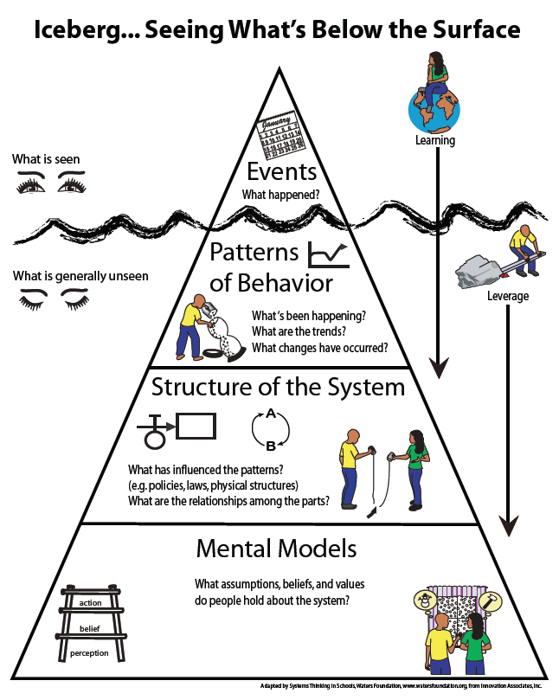
Notes:
Dynamické myšlení – neorientovat se pouze na historii nebo na jedno rozhodnutí co se udělá ale co se bude dělat (čeština na to má dokonavý a nedokonavý vid ☺)
Operační myšlení – ekonometrický model pro predikci produkce mléka (řada složitých rovnic a makroekonomických ukazatelů, ale nic nevyjadřovalo počet krav)
Spojité myšlení – ano jsem poeta, ale určitě to není 50 odstínů. řada aspektů světa kolem nás je spojitá, jen se běžně diskrétně měří, lidské reakce jsou spojité
Strukturální myšlení – struktura není libovolná, je dána fyzikálními zákony, biologií, ekonomikou, prostou logikou…. Jednotky nám toto hlídají

Slide 28
System science
System science was necessary. (von Bertalanffy, 1968)
Reasons for system science
Problems that we solve are more and more complex.
We need different (holistic) point of view.
Growth of specialization
Experts from different fields do not understand each other.
System approach was supposed to be the way of communication and transfer.

Slide 29
System science
Interdisciplinary field
Study the general principles
Identifies isomorphism
Transfer of principles, models, laws between different fields
Provides the universal language for various scientific disciplines
Not all goals are fully achieved
Notes:
Isomorphism bijective homomorfism, one-to-one correspondence between the elements of one and those of the other and if the relations among the elements are preserved by the same correspondence

Slide 30
Systems science
History
Roots in 1930s
Development from 1950s
1954: Society for General Systems Research
Ludwig von Bertalanffy (biologist; open systems)
Anatol Rapoport (mathematician, psychologist; game theory – parasitism and symbiosis)
Ralph Waldo Gerard (neurophysiologist)
Kenneth Eward Boulding (economist)
1980: society renamed to International Society for the Systems Sciences

Slide 31
Some theoretical frameworks (I)
Cybernetics
mathematician Norbert Wiener
Focus on:
structure and control of systems
information transfer
feedbacks
ISSS: „…a science of control and information, with an emphasis on the particular relationship of feedback.“
Notes:
You will se that the basic definitions of the different disciplines are very close. Sometimes it works with same problems but have different roots. Big intercestions.
All of „…look at all sides of the problem“

Slide 32
Some theoretical frameworks (II)
Operations Research
Expansion during WWII
Apply mathematical methods on problems from economy, logistics, military, organisational… areas
Soft vs Hard OR

Slide 33
Some theoretical frameworks (III)
Systems Engineering
1940s: Bell Telephone Laboratories
Focus on design, implementation, realisation, operation of artificial systems

Slide 34
Some theoretical frameworks (IV)
Systems analysis
Systemic approach to problems
Every existing system can be improved
Close to operations research

Slide 35
Some theoretical frameworks (V)
System dynamics
J. W. Forrester
Focus on behaviour of complex systems in time (commonly on socioeconomic systems) .
Typical attributes of such systems (typical point of view of SD):
Delays
Feedbacks
Nonlinearities

Slide 36
Problem
Try to define the term: “problem“.
Well structured vs. Unstructured problems
Strategic control | Unstructured problems
Managerial control |  | Semi structured problems
Operational Control |  |  | Well structured problems
Notes:
Obstacle, difficulity, situation that need solution.
Well structured: decision with all neccessary information, we know the procedures, methods to solve the problem, we know results of analogue situations…
Unstructured: fragmentry information, we don‘t know the methods, problem situation is new…

Slide 37
Operations Research
Hard vs. Soft Operations Research
What is the Soft OR?
Starting point – you can optimise only easy vague problems (strictly said).
Notes:
You know lot about hard operations research. You used some of its methods during previous semester.
SOFT OR – sometimes use term problem structuring methods.

Slide 38
Soft OR
Usually try to capture the group's perception of the problem.
Do not try to get objective definition of the problem, focus on many subjective definitions.
Uses verbal and graphical models of the system.

Slide 39
SOFT OR vs. HARD OR
Hard systems thinking | Softsystems thinking
Oriented to goal seeking. | Oriented to learning.
Assumes the world contains systems that can be engineered. | Assumes the world is problematic but can be explored using system models.
Assumes system models are models of the world (ontology-based). | Assumes system models are intellectual constructs (epistemology-based).
Speaks of “problems“ and “solutions“. | Speaks of “issues“ and “accommodations“.
Advantage: Allows the use of powerful techniques. | Advantage: Available to both problem owners and professional practitioners. Keeps in touch with the human content of problem situations.
Disadvantage: May need professional practitioners. May lose touch with aspects beyond the logic of the problem situation. | Disadvantage: Does not produce final answers. Accepts that inquiry is never-ending.
P. Checkland, 1985
Notes:
Ontologie je filozofická disciplina, která se zabývá jsoucnem, bytím jako takovým a základními pojmy.
Epistemologie (nebo gnoseologie, noetika) je filozofická disciplina, která zkoumá lidské poznání, jeho vznik, proces a předmět.

Slide 40
Soft Systems Methology
Author P. Checkland
Belongs to soft OR
Another examples e.g. Strategic Choice or Strategic Options Development and Analysis

Slide 41
Example of Soft OR: Soft Systems Methodology
1960s P. Checkland
Seven stage model
1) Situation considered problematic
2) Problem situation expressed
3) Root definitions of purposeful activity systems
4) Conceptual models of the systems named in the root definitions
5) Comparison of models and real world
6) Changes: systematically desirable, culturally feasible
7) Action to improve the problem situation
Real world
Systems thinking about real world

Slide 42
SSM - Stages 1 and 2
Finding out
Enter the problem situation
Identify peple, culture, politics
Notes:
Stages 1 and 2: Finding out
- commodities of power and how they are obtained, used, preserved and transmitted
get the data
Should contain poit of view of all relevant people
Broad brush approach
Show example

Slide 43
SSM - Stages 1 and 2
Rich picture
Graphical reperesentation that describe all stakeholders their interests/concerns and interactions
Created during interviews with all participants on problem situation
There isn‘t one correct way how to draw the rich picture
Notes:
Stages 1 and 2: Finding out
- commodities of power and how they are obtained, used, preserved and transmitted
get the data
Should contain poit of view of all relevant people
Broad brush approach
Show example

Slide 44
SSM - Stages 1 and 2
Rich Picture – three basic aspects
Structure
Changes only slowly
Hierarchy, geographical displacement etc.
Express only structure that is relevant to interests and processes
Processes
Transformation, flows of goods, documents, information…
Interests
Concerns, issues
Individual motivation of depicted persons and groups
Notes:
Stages 1 and 2: Finding out
- commodities of power and how they are obtained, used, preserved and transmitted
get the data
Should contain poit of view of all relevant people
Broad brush approach
Show example

Slide 45
SSM - Stages 1 and 2
Rich Picture – advices (Monk & Howard, 1998)
Interests expression – use the comics bubles
Tension or Conflict expression – use pictogram (e.g. Crossed swords)
Use the language of depicted people (Rich picture is used for the communication)
Use the style that fits you and persons you communicate with
Notes:
Stages 1 and 2: Finding out
- commodities of power and how they are obtained, used, preserved and transmitted
get the data
Should contain poit of view of all relevant people
Broad brush approach
Show example

Slide 46
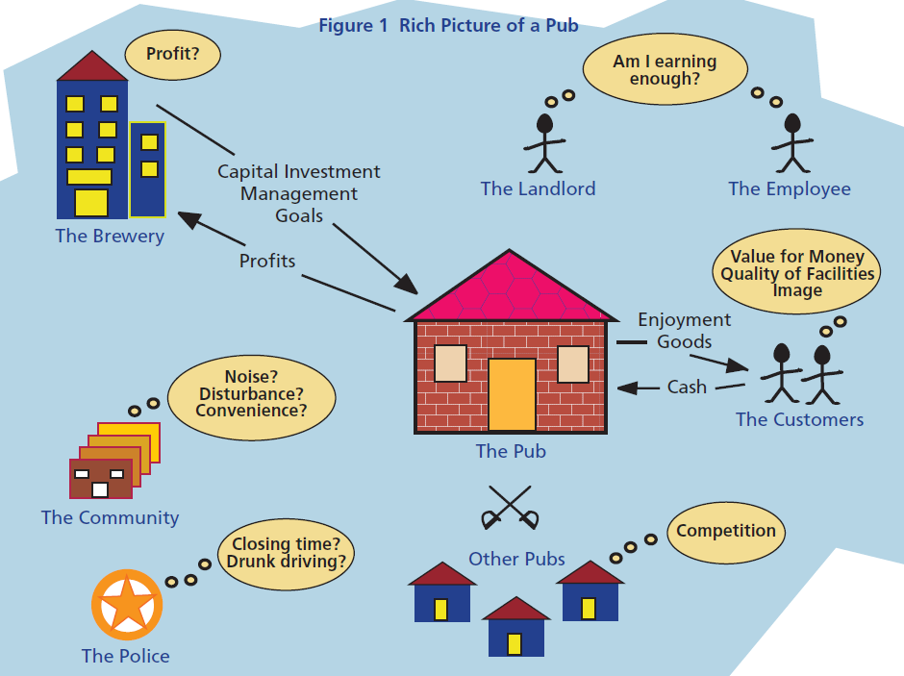
Monk & Howard (1998)

Slide 47
SSM - Stage 3
Root definitions (at least one)
CATWOE
Sentences that describe IDEAL system
C – customers (victims/beneficiaries) of the system
A – actors/participants in the system
T – transformation process in the system, what inputs are transformed into what outputs
W – weltanschauung (worldview), what is the worldview underlying the system, purpose of the transformation
O – owner of the system, who has the power to stop the system
E – environmental constraints that are out of thy system but have effect on it and need to be considered?
Notes:
Example
Problem – only small number of skilled gradua tes of universities
Try to make root definition
C – society – employers atc.
A – students, teachers
T – prepare the students for future live inputs students, outputs the skilled worker or enterpreneur
W – desire to enhance and obtain the knowledge and skills usefull at workforce marked
O – government
E – marked, demography, natural constraints of inteligence (small number of people of appropriate age -> small number of skilled students…)
The education system is a system for ensuring…

Slide 48
SSM - Stage 3
Example:
Lets have a problem:
„The tertiary level of education doesn‘t provide graduates skilled enough for the job market.“
Define CATOWE
Notes:
Example
Problem – only small number of skilled gradua tes of universities
Try to make root definition
C – society – employers atc.
A – students, teachers
T – prepare the students for future live inputs students, outputs the skilled worker or enterpreneur
W – desire to enhance and obtain the knowledge and skills usefull at workforce marked
O – government
E – marked, demography, natural constraints of inteligence (small number of people of appropriate age -> small number of skilled students…)
The education system is a system for ensuring…

Slide 49
SSM – Stage 4
Conceptual model
Is developed on the basis of root definitions
Uses diagrams, links the activities
Contains statements describing the activities which are needed by the R.D.
Usually contains 7±2 activities
3E:
the effectiveness of the system (right thing to do)
the efficacy of the system (does it work?)
the efficiency of the system (ratio of outputs and used resources)
How the system should work
Notes:
5-9 activities
Monitoring the required skills
↓
Identify the training needs
↓ ↘
Adjust the Train the teachers
requirements on students ↙
↘ ↙
Studey/teach the appropriate topics ← Identify the materiál support
↓
Prepare the graduate

Slide 50
SSM – Stages 5 - 7
Comparison with the real world
Does this happen in real world.
How? How it is judged?
Sometimes get back to root definitions.
Basement for discussion and ideas generator.
Changes
What must be changed in real world (feasible and desirable)
Action
Implementation of changes
Notes:
Criticism of Soft OR and SSM
Consensus does not mean the right way.

Slide 51
Soft OR - criticism
The goal is concensus of the stakeholders but it isn‘t necessarily the god thing
For our purposes we will undestand soft OR as “Problem structuring methods“
i.e. it is important but we do not consider it final solution
We can use it as preparation before application of hard OR (in Checkland‘s original work the authors admits „occasionally condense to“)
Notes:
Přirovnání k náboženství (respektive to umí přebrat případné negativní vlastnosti některých církví :-D)
Soft OR is still relatively controversial. In many respects soft OR has taken on some of the attributes of a religion:
it has adherents and followers (believers)
believers believe that soft OR is "the one true way", all other ways are wrong
believers attack (verbally) non-believers in the scientific press
believers often want to "change the world for the better", this often manifests itself in a desire to use soft OR to impact upon strategic/social issues
belief is based on faith rather than evidence

Slide 52
The goal is concensus of the stakeholders but it isn‘t necessarily the god thing
For our purposes we will undestand soft OR as “Problem structuring methods“
i.e. it is important but we do not consider it final solution
We can use it as preparation before application of hard OR (in Checkland‘s original work the authors admits „occasionally condense to“)
Notes:
Přirovnání k náboženství (respektive to umí přebrat případné negativní vlastnosti některých církví :-D)
Soft OR is still relatively controversial. In many respects soft OR has taken on some of the attributes of a religion:
it has adherents and followers (believers)
believers believe that soft OR is "the one true way", all other ways are wrong
believers attack (verbally) non-believers in the scientific press
believers often want to "change the world for the better", this often manifests itself in a desire to use soft OR to impact upon strategic/social issues
belief is based on faith rather than evidence

Slide 53
Thank you for your attention.

